Slide 1
Networking Fundamentals
Foundations of Ethernet and IP

Slide 2
Longest Match Routing
#
Layer 3 routing decisions

Slide 3
Prefix Length
The length of a subnet mask is called the prefix length
This is because the network portion of the address is called the prefix
The longer the prefix, the fewer host bits in the address
The fewer the host bits, the more specific the route
11111111.11111111.11111111.11000000
11111111.11111111.11111000.00000000
|----------26 bits----------|
|-------21 bits--------|
|----------network----------|
|hosts|
|------- network-------|
|---hosts--|

Slide 4
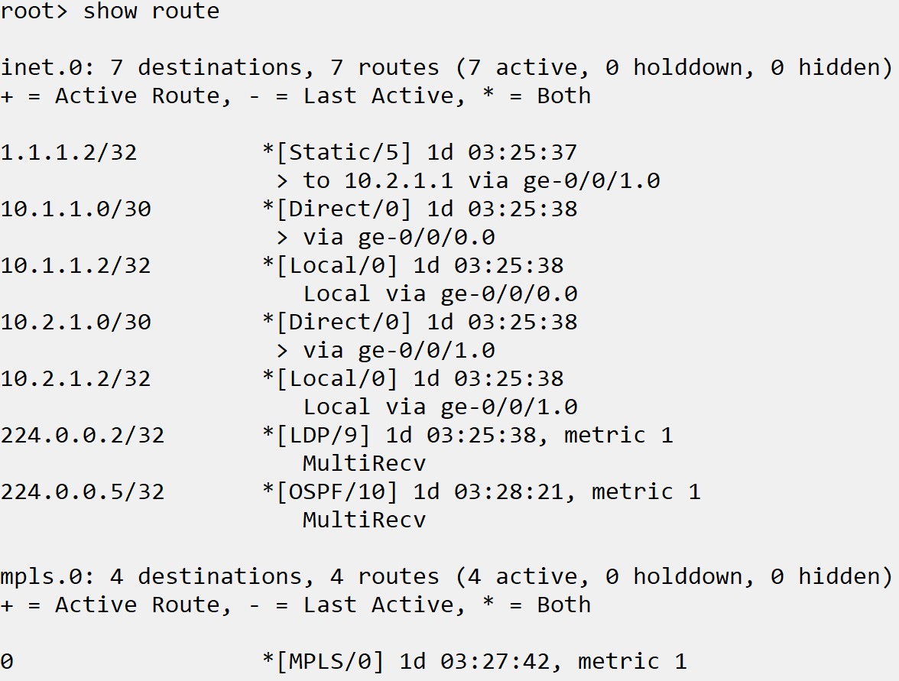
Routing Table Contents
Prefix
Protocol
Next hop
Including Interface
Age

Slide 5
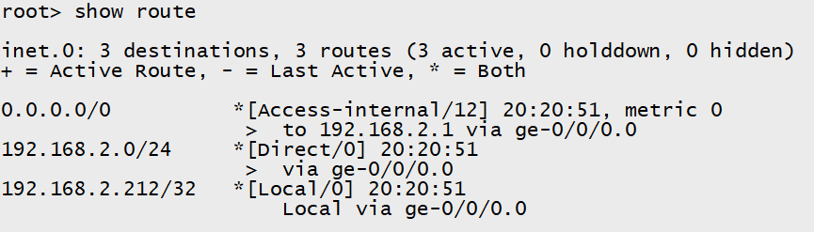
Longest Match
If multiple routing entries include the destination IP, the longest match is used
Examples:
Destination IP = 192.168.2.4
192.168.2.0/24 route is used
Destination = 172.16.0.4
0.0.0.0/0 route is used

